Slide 1
PROJECT NAME - MULTIPLE DISEASE PREDICTOR
TEAM NAME - DIAGNOTECH
TEAM LEADER- SANDEEP YADAV (2327CSE1258)
TEAM MEMBERS- 1. SHUBHAM YADAV (2327CSE1275)
2. SHAILESH KUMAR (2327CSE1240)

Slide 2

Disease Outbreak Prediction and Epidemiological Modeling for Kidney Disease, Diabetes, and Heart Conditions
Predictive modeling uses statistical methods to forecast disease outbreaks and trends. It is a valuable tool for public health professionals to understand the spread of chronic diseases.

Slide 3
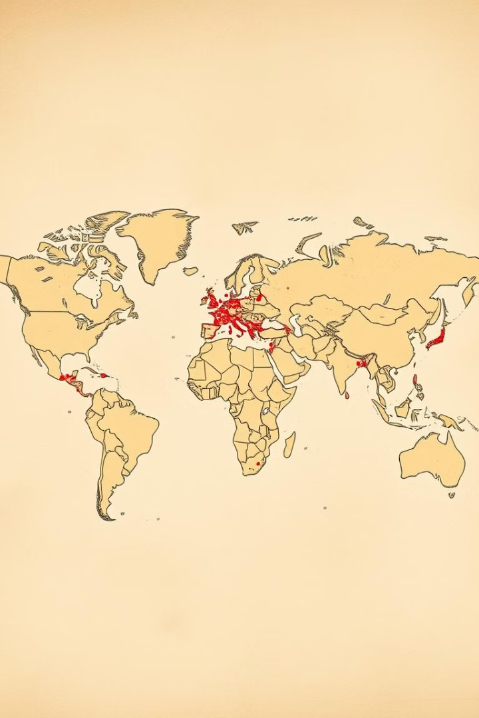
Understanding the Epidemiology of Chronic Diseases
1
Prevalence and Incidence
2
Risk Factors
Identifying key risk factors, such as age, genetics, lifestyle, and environmental factors, is important for developing effective interventions.
Understanding the prevalence and incidence of chronic diseases like kidney disease, diabetes, and heart conditions is crucial.
3
Disease Progression
Analyzing the progression of these diseases, from early stages to complications, provides valuable insights for treatment strategies.

Slide 4
Data Sources and Collection for Disease Modeling
Electronic Health Records
Population Surveys
Administrative Databases
Electronic health records (EHRs) provide a rich source of patient data, including demographics, diagnoses, medications, and lab results.
Surveys conducted on representative populations can gather data on disease prevalence, risk factors, and health behaviors.
Administrative databases, such as those from insurance companies or government agencies, can provide insights into healthcare utilization and mortality rates.

Slide 5
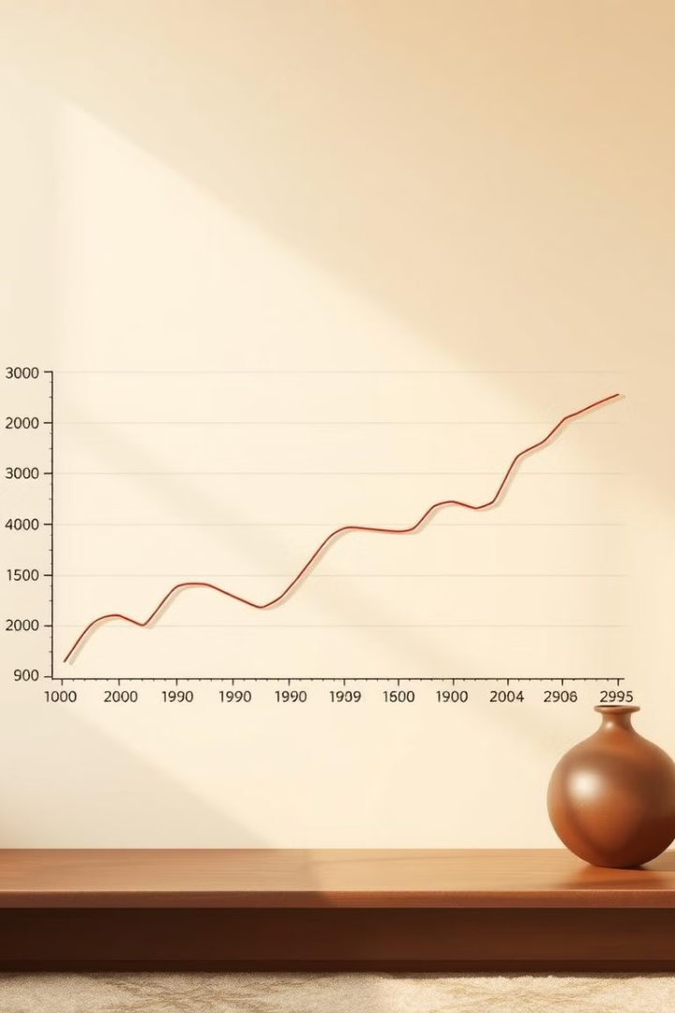



Statistical Techniques for Predictive Modeling
Regression Analysis
Regression models are used to identify relationships between variables and predict disease outcomes based on risk factors.
Machine Learning
Machine learning algorithms, such as support vector machines and neural networks, can learn complex patterns from data and make accurate predictions.
Time Series Analysis
Time series analysis techniques can be used to identify patterns and trends in disease data over time, enabling forecasting of future outbreaks.

Slide 6
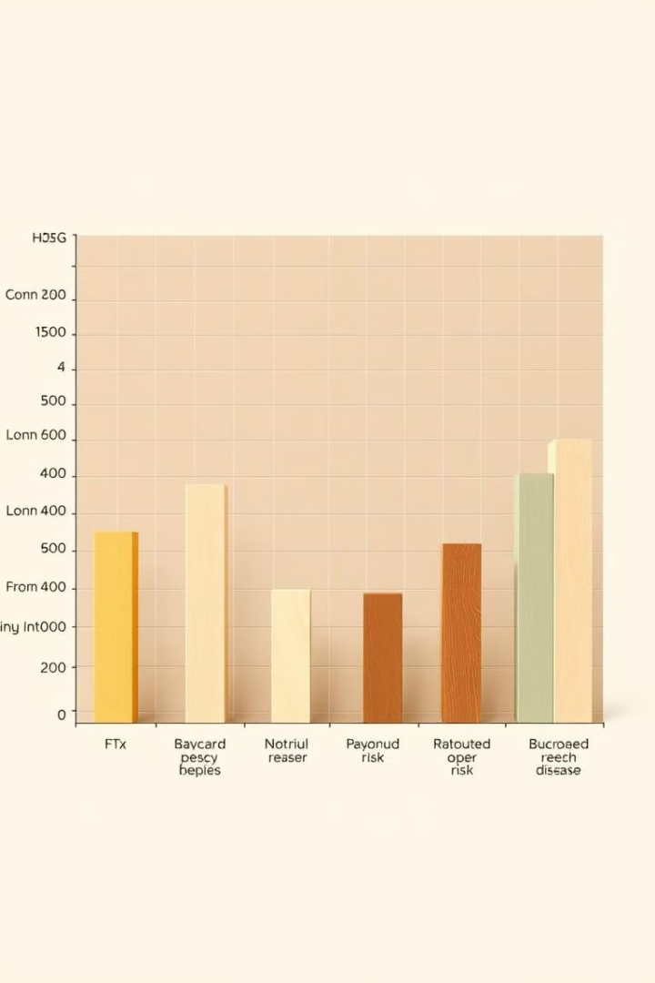
Incorporating Risk Factors into Epidemiological Models
Risk Factor
Impact on Kidney Disease
Impact on Diabetes
Impact on Heart Conditions
Age
Increases with age
Increases with age
Increases with age
Family History
Strong genetic component
Strong genetic component
Strong genetic component
Lifestyle
High blood pressure, smoking
Obesity, physical inactivity
High cholesterol, smoking

Slide 7
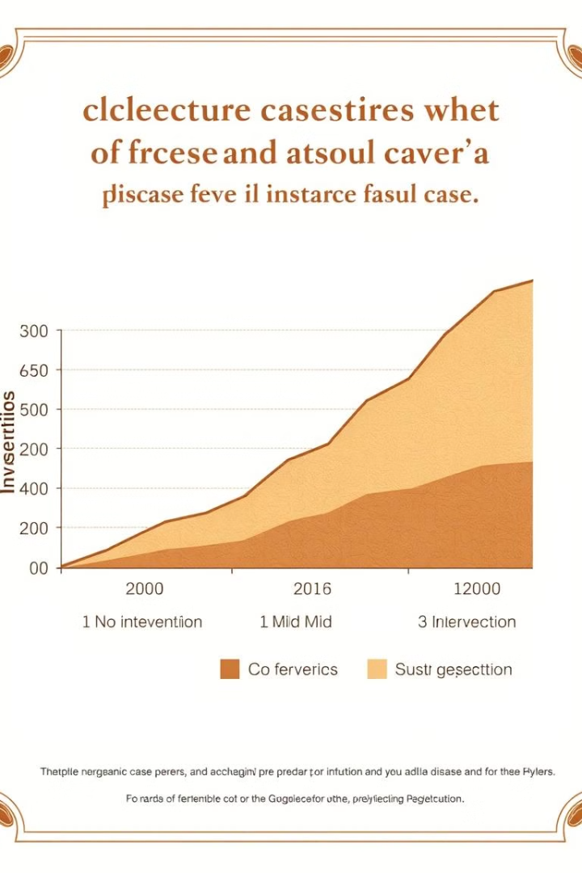
Forecasting Disease Outbreaks and Trends
1
Data Collection and Cleaning
Accurate data collection and cleaning are essential for building reliable predictive models.
2
Model Development and Training
Training models on historical data and validating them against known outcomes is crucial for model accuracy.
3
Forecasting and Scenario Analysis
Using the trained model to project future disease trends under different scenarios, such as intervention strategies, helps inform decision-making.

Slide 8
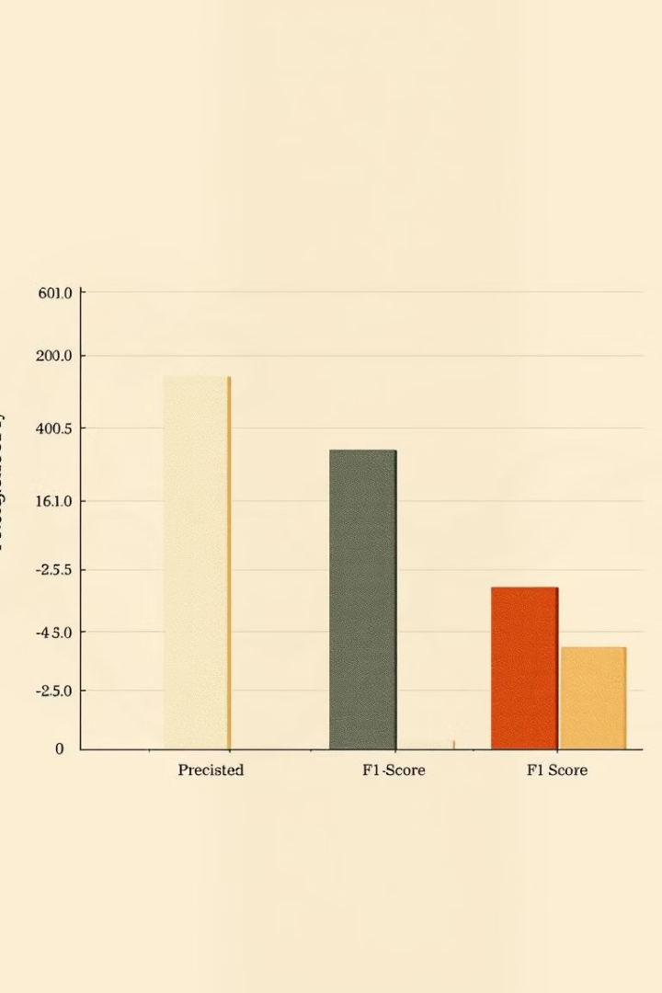
Evaluating Model Performance and Accuracy
Sensitivity
Specificity
The ability of a model to correctly identify disease cases.
The ability of a model to correctly identify non-disease cases.
Precision
The proportion of correctly predicted disease cases among all predicted cases.

Slide 9





Applying Predictive Models to Inform Public Health Interventions
Targeted Screening
Vaccination Campaigns
Models can identify individuals at high risk for disease and prioritize targeted screening efforts.
Predictive models can help allocate vaccine resources effectively and target areas with high risk of outbreaks.
Early Intervention
Public Health Education
Early intervention strategies can be implemented based on model predictions to reduce disease progression and improve outcomes.
Public health campaigns can be tailored to address specific risk factors and behaviors based on model insights.

